Slide 1
Family Relationships, Culture, and Adolescent Development

Slide 2

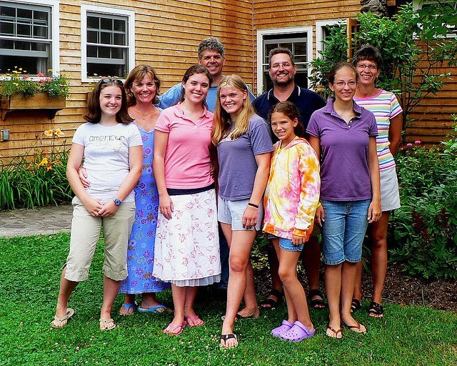

Influence of Families on Development
Even though peers are playing an increasingly important role in the life of an adolescent, family still influences their development.

Slide 3
Family Systems Approach
To understand family functioning one must understand how each relationship within the family influences the family as a whole
The family system is composed of a variety of subsystems
EXAMPLE:
The subsystems in a family consisting of two parents and a teen would be:
      Mother and teen
      Father and teen
      Mother and father

Slide 4
Family Systems Approach
Two key ideas:
  Each subsystem influences every other subsystem in the family
  A change in any family member or family subsystem results in a period of disequilibrium until the family system adjusts to the change.

Slide 5
Sibling Relationships
Five common patterns in adolescents’ relationships with siblings
Caregiver relationship
Buddy relationship
Critical relationship
Rival relationship
Casual relationship

Slide 6
Parent/Adolescent Conflict…
Conflict with parents increases sharply in early adolescence and remains high for several years
Conflict in adolescence is especially frequent and intense between mothers and daughters
It is only in late adolescence and emerging adulthood that conflict with parents diminishes substantially
What are some of the common conflicts occurring during these years? Possible developmental outcomes?

Slide 7
Parenting Continuum
Parenting has been described as a continuum between
two dimensions
Demandingness (i.e., control)
The degree to which parents set down rules and expectations for behaviour and require their children to comply with them
Responsiveness (i.e., warmth)
The degree to which parents are sensitive to their children’s needs and the extent to which they express love, warmth, and concern for their children

Slide 8
Parenting
Parenting style can influence adolescent rebellion.
Even small resistance from an adolescent my be seen as rebellion if parents are controlling (authoritarian).
On the other hand, permissive parents may allow an adolescents to engage in many seemingly rebellious behaviours and not consider it rebellious.

Slide 9
What Parents Might Say…
Authoritarian
Authoritative
“No you can’t go to the mall today. We made plans to visit your aunt in the hospital. How about we drop you off at your friend’s house on the way home? Good enough compromise?”
“Do it my way because I said so! Don’t argue with me … it’s my house and my rules”
Adolescent: “Mom are you home? … Mom?” {no answer} … Adolescent: “I guess I make my own dinner again”
“Sure you can have a party in the house while we’re away – the key to the liquor cabinet in is your father’s sock drawer”
Disengaged
Permissive

Slide 10
Experiences within families
Differential Parenting
Parents’ behaviour often differed toward siblings within the same family
Non-shared environmental influences
Siblings experience quite different family environments
Consequences of these differences are evident in their behaviour and psychological functioning

Slide 11
Despite the amount of conflict that occurs between parents and teens …
Most adolescents like, trust, and admire their parents
Disagreements are usually about minor issues (e.g. clothes, curfew)
Adolescents and their parents agree on many of the most important aspects of their views of life

Slide 12
Secure attachment to parents in adolescence is related to a variety of favourable outcomes
Effects on Adolescents
  Higher self-esteem and well-being
  Better psychological and physical health
  Closer relationships with friends and romantic partners
  More autonomous and self-reliant

Slide 13
Running Away from Home
About 1 million adolescents run away from home each year in the U.S & Canada.
About ¼ of these are “throwaways” – their parents forced them to leave
Adolescents who run away have often experienced high conflict with their parents
Many have experienced physical or sexual abuse
Adolescents who run away tend to be highly vulnerable to exploitation
However…
Youth who sleep on the street do not necessarily come from abusive families, as one common stereotype dictates (Benoit & Jensson, 2009).

Slide 14

Street Families
Running away from a family doesn’t mean running away from families.
Street kids create street families among themselves
  Safety/protection
  Companionship
  Comfort and intimacy
  Feelings of belonging and acceptance
  Shared roles and duties

Slide 15
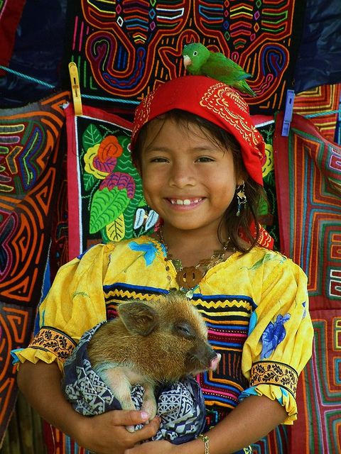
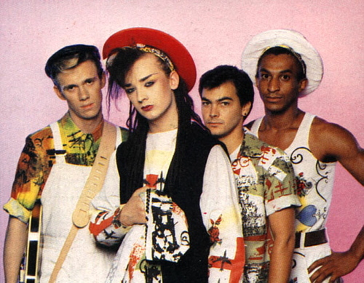

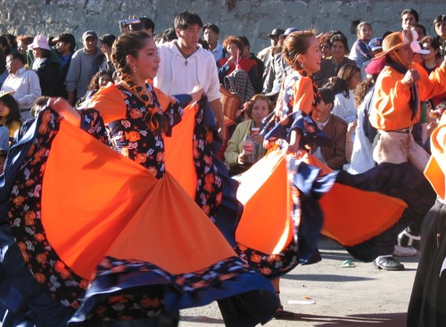
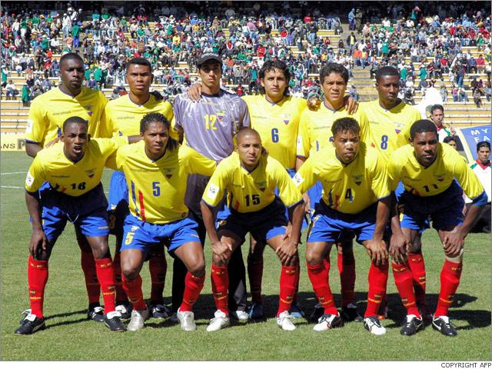
Culture and Development

Slide 16
Cultural Beliefs are…
“ideas and understandings, both implicit and explicit, about persons, society, nature and divinity” (Shweder et al, 1998, p. 868)
Norms and moral standards that arise from these beliefs, ideas and understandings

Slide 17
Socialization is…
The process by which people acquire the behaviors and beliefs of their culture
Socialization Outcomes
  Self-regulation – ability to comply with social norms
  Role preparation – for roles in work, gender, institutions such as marriage, parenthood
  Cultivation of sources of meaning – “what’s important?” “What’s to be lived for?”

Slide 18
Adolescents become increasingly aware of cultural roles and what is expected of them due to
  Increased cognitive capacities in adolescence (i.e., abstract thinking & self-reflection)
  Understanding that with transition to adulthood they’re expected to adapt to adult role requirements
Notes:
Increasing cognitive capacities in adolescence (i.e., abstract thinking & self-reflection)
The transition to adulthood is approaching along with the need to adapt to adult role requirements

Slide 19

Cultural Values
Cultural values are often divided into two distinct types. In reality, cultural and family values can more easily be explained using a continuum.
Individualism | Collectivism
Independence Self-expression Broad socialization “Western” | Obedience Conformity Narrow socialization “Eastern”
Keep in Mind
--There are individual differences in any culture
    -Diversity also exists within individuals

Slide 20
Religious Beliefs & Cognitive Development
Fowler’s Stage
Age
Poetic-conventional faith
Early adolescence
Awareness of symbolism; More than one way of knowing the truth; abstract thought regarding God and faith
Individuating-reflective faith
Late adolescence/ emerging adulthood
Question beliefs, incorporate personal experiences,
Develop individualized faith.

Slide 21
Moral and Ethical Development
Culture and religious beliefs can influence what an individual sees as moral and/or ethical. Recent theories of moral development try to take different views into account.

Slide 22
Worldviews Approach: 3 “Ethics”
Ethics of Autonomy | Ethics of Community | Ethics of Divinity
Individual is primary moral authority having right to do as they wish as long as their behavior does no harm to others | Responsibilities of roles in family, community are basis for moral judgments | Individual is a spiritual entity subject to the prescriptions of a divine authority
Jensen has proposed a worldviews theory as a culturally-based alternative to Kohlberg’s theory of moral development.

Slide 23
Worldview
Links moral reasoning to:
Cultural context
What it means to be human
What the world is like
Why people suffer
How to overcome suffering
It places increased attention on the transmission of moral concepts from some members of a community to others.
How does this compare to Kohlberg's theory and his stages?

